Slide 1
Think Tank 2022
4th Annual Think Tank Presentation
March 2nd at 2-3:30pm
Presented by SAC

Slide 2
Presenters
Katie Werth
School’s Out for Summer
Wade Tripp
Clean up and Reset Week
Haley Weatherford
Full Circle Reviewing
Rita Wilson and Melissa Johnson
Staff Swab the Deck Day

Slide 3
School’s out for summer
https://park.zoom.us/rec/share/ZyJgNQf1z7BPE6aFHPHBH0cfu01Vq2KiOXCUkB7LXvINXrlVHOBtxZc8AYAJD9SX.qIF7MhZ_9m9O9AHi?startTime=1646065227000

Slide 4
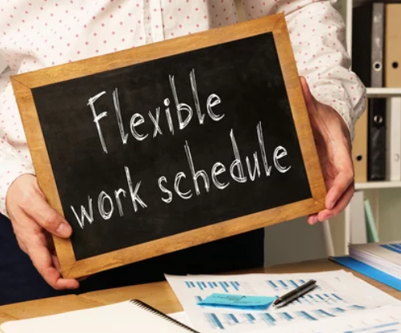
School’s out... NOW WHAT
Would a more flexible schedule during the summer months support your work life balance?
Would you like to ease the worries of finding child care and possibly save money in the process?
Would you like to work from the comfort of your own home in an office with a window?
If you’ve answered yes to one of these questions, this proposal is for you! ☺

Slide 5
What is School’s out for Summer?
SOFS is an idea to give staff members more flexibility to their work schedules over the summer months. This might include working more remote days, varied start times, etc.
Staff members will have the opportunity from June 1– Aug 1 to work a more flexible schedule. A Telework Agreement with your proposed schedule change would be required.
* April 1: The agreement is submitted to Supervisor for approvals.
* May 1: Supervisor gives approval notice to employee.
* May 10: HR receives the signed agreement.
If a staff member is needed for an in-person meeting over the summer, they would be obligated to attend as part of their duties.
I understand not all staff positions have the ability to work remotely and not all staff members want to work remotely, but for those that are interested, this would be a great opportunity.

Slide 6
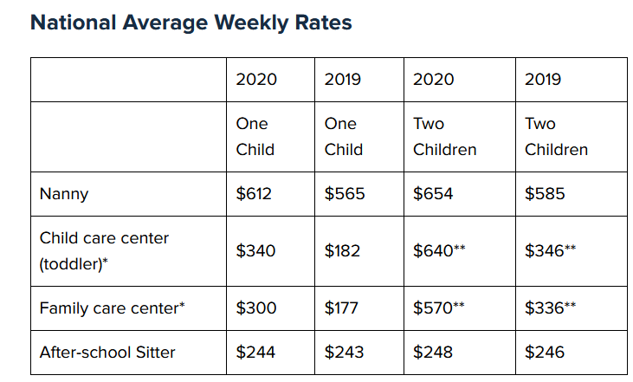
How does this benefit the Staff?
Child care cost savings for 8 weeks ranges from
$1,600 to $5,600 at a rate of $200-$700 a week.
Staff, C. E. (2021, August 8). This is how much child care costs in 2021- National Average Weekly Rates. Care.com Resources.
Many of our staff members have children out of school over the summer months, hence the title “School’s Out for Summer.” More flexibility would be welcomed.
This initiative is not only for staff with children. Staff who do not have children, are able to share in this added benefit as well.

Slide 7
How does this benefit the university?
Staff would view this as an additional “benefit” offered by the university.
No cost to the university.
An opportunity to save money on utilities and general supplies. With fewer employees on campus, building maintenance and summer projects can continue with little to no interruptions to staff during work hours.
“Percolate Park” is free advertising for the university with the opportunity to build community where staff members reside.
Employees gain a new perspective and return rejuvenated for the start of the new academic year.

Slide 8
Thank you for your time and consideration.
Who: Staff
What: Participate in SOFS
When: June 1- Aug 1
Where: Remote or on campus
Why: Reduce stress, save money, build community and gain a new perspective

Slide 9
Park P.R.I.M.E. Week
Setting up to make
Park University Work Better
https://drive.google.com/file/d/1qLIAycw1e_nvtjJUhN9HuVto6EbPqqLU/view?usp=sharing

Slide 10
P.R.I.M.E. Week What is it?
One week each year, each area/department gets a break to reset, update, and organize. During the Plan Research Implement Manage Evaluate week they work to improve the process and policy to make it easier to work the other 51 weeks.
PARK.EDU

Slide 11
How it works --
• Rather then the normal day to day work, the area looks at where they spend most of their time and energy and figure out how to make it better and get rid of lingering issues in the backlog. • Train yourself and others • Review procedure and ask “Why do we do this and how can we do it better?”
• Get rid of lingering issues and do things (reset password, clean up inboxes) that have been hanging around • Ask other departments for help.
PARK.EDU

Slide 12
What PRIME week is NOT
Time for a vacation
It is suppose to be hard work, to get ahead
Bullet point
A retreat or team building exercise
The idea is to work with the university, reach out,
PARK.EDU

Slide 13
Sample Week
Plan | Research | Implement | Manage | Evaluate
Monday | Tuesday | Wednesday | Thursday | Friday
Focus on planning, seeing who does what and where to work on, get old items and inbox off the desk and clear | Focus on how to make things better, reach out to other departments | Implement and do the changes, work on making it better | Finish the implement, see if it worked | Evaluate what worked and what did not, changes you like to make
PARK.EDU

Slide 14
It will be different for each area
Each area will be different, focused on a calm time for that area.
Some prep work ahead of time to let other areas know what is happening so
- Other areas can avoid giving you deadlines or schedule meetings during that time
- Arrange training for equipment (ITS), get better reports (OIE), or better understanding degree audits (Registrar)
PARK.EDU

Slide 15
Sample items for PRIME week for ITS Developers
Clear and Reset passwords
Go to Student Support and see how they use CX/MyPark
Let other areas that systems may go down shortly during the day
Walk though and see what a normal day is and see how they use systems and what they need
Tricks for the degree audit
Bullet point
Reinstall latest software tools
Clean install latest software versions and tools. Bullet point
Review documentation
Go though Freshdesk and MyPark to see what information is outdated, needs to be deleted, and cleaned up.int
Bullet point
Clean up inbox and tickets
All the stuff put off till later to improve things, do it during this time.
PARK.EDU

Slide 16
Pros
Cons
No major money cost
Help long term efficiency
Helps create better communications between departments
Lots of extra work and then catch-up
Not enough time in a week to do everything
Needs to have the entire university to share the extra work
Could use a better name

Slide 17
I hope you like the proposal
Wade Gregory
Tripp
PARK.EDU

Slide 18
Full-Circle Reviewing
Haley Weatherford, Downtown KC Campus Center Coach
Notes:
>Thank you to SAC for choosing my presentation today >When choosing my presentation, I wanted to look to business leaders to tap into current conversations and topics to bring innovative change into Park

Slide 19
The Breakdown
Approximately 33 million Americans have quit their jobs since Spring 2021
It costs 50-200% an employee’s salary to replace them
#3 reason for leaving in 2019 was their manager--#6 in 2020
Career Development was #1 in both 2019 and 2020
Conclusion?
Productive conversations about manager development and growth aren’t happening in the workplace
Solution?
Notes:
>We’ve all heard of the Great Resignation >50k$ math example >Third reason for leaving for 2019 was their manager, 6th reason for 2020 >People are leaving their managers, organizational structure, organizational structure

Slide 20
Full-Circle Reviewing
A 360 degree of view of the health of the department
Identify potential harmful patterns to intervene on, AND potential impact players to tap for promotion opportunities
Fosters a culture of humility—everyone can receive feedback good, bad, and neutral
Notes:
>Could be reverse performance reviewing, could be 360 degree >When managers are reviewed by direct reports and not just direct report reviewed by manager >Not just forecast the bad, but also ID the great benefits for potential promotion opportunities for the future

Slide 21
How?
$?
Undetermined, but highest cost is predicted to be in labor hours*
*Back to this point later
Anonymity, Anonymity, Anonymity
No names attached
Send to HR + highest name in org chart for review with manager
No long form sections to accidentally ID self
Write with intention
Write surveys purposefully, clearly, and with exact intention of metrics to quantify
Notes:
>I don’t have HR budget or paycor paid features view >Anonymity protects for trust and candor as well as retaliation >Reviewing with highest in org chart reviews 1 meeting with 5 reviews, not 5 meetings with 1 review to save time >We’ve all seen bad surveys!!

Slide 22
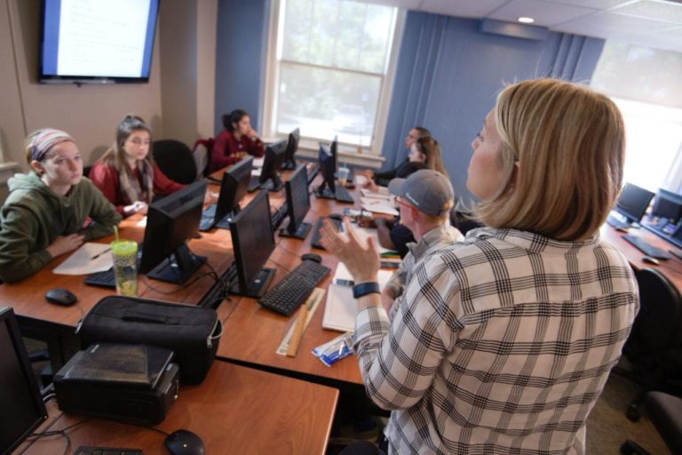
Why?
ACCOUNTABILITY
CIVILITY and RESPECT
EXCELLENCE
GLOBAL CITIZENSHIP
INCLUSIVITY
INTEGRITY
Notes:
>No current mechanism for staff w/o direct reports to formalize feedback and their voice >Civility and Respect: fosters constant conversation >Excellence: We’re failing our managers by not giving them feedback ‘rise all boats’ >Global Citizenship: caring for our neighbors by giving our criticism >Inclusivity: Including all levels for all conversations >Integrity: Internalizing feedback, which isn’t here, and saving $ for turnover

Slide 23
Sources
DaSilva, J. (2021, November 22). Want to reduce turnover? have employees review their managers. HR Exchange Network. Retrieved February 20, 2022, from https://www.hrexchangenetwork.com/employee-engagement/articles/want-to-reduce-turnover-have-employees-review-their-managers
Lerner, M. (2017, May 16). Develop better talent with reverse performance reviews: Mediabistro. Creative Jobs - Careers for Graphic Designers, Copywriters, Social Media Managers, Proof Readers and More. Retrieved February 20, 2022, from https://www.mediabistro.com/employer/blog/best-practices/develop-better-talent-reverse-performance-reviews/#:~:text=Fortunately%2C%20there's%20a%20better%20way,your%20employees%20review%20your%20company.
Mahan, T., Nelms, D., YI, J., Jackson, A., Hein, M., & Moffett, R. (2020). 2020 Retention Report: Insights on 2019 Turnover Trends, Reasons, Costs & Recommendations. Work Institutes 2020 Retention Report. Retrieved February 20, 2022, from https://info.workinstitute.com/hubfs/2020%20Retention%20Report/Work%20Institutes%202020%20Retention%20Report.pdf
McFeely, S., & Wigert, B. (2019, March 13). This fixable problem costs U.S. businesses $1 trillion. Gallup.com. Retrieved February 20, 2022, from https://www.gallup.com/workplace/247391/fixable-problem-costs-businesses-trillion.aspx
Nelms, D., Mahan, W., Huddleston, K., Jackson, A., Spinner, G., French, S., Dean, S., & Witherow, R. (2021). 2021 Retention Report The Covid Edition: Employer Turnover, Insights, and Trends in 2020. Work Institutes 2020 Retention Report. Retrieved February 20, 2022, from https://info.workinstitute.com/hubfs/Retention%20Reports/2021%20Retention%20Report/Work%20Institutes%202021%20Retention%20Report.pdf

Slide 24
Campus Beautification Projects
Purpose
Impact
Alignment
Creating a legacy with a focus on community through beautification projects to include practical and visual improvements.
To become better stewards and global citizens of our campus, through beautifying the community, and improving the environment.
Aligns with Park’s strategic goals to strengthening our alliances with campus and deepening our relationships with community members and businesses.

Slide 25
Purpose
.
To make practical and visual improvements on campus or in the community that our campuses are located in.

Slide 26
Examples
Environment
Trash Pick-up
Restoration
Art
Recycling, planting bulbs, trees and shrubs along curbs, paths, and streets, establishing, improving upon existing, and helping community gardens
Picking up trash alongside roadways, with highway approval, paths, parks, and shares spaces
Landmarks, buildings, signs
Adding murals for existing blank spaces, local artists and students encouraged

Slide 27
Logistics
Any staff member from any campus can propose a Beautification Project.
Staff Council will review all proposals and determine the feasibility for that year based on priority.
Funding will affect project approvals.

Slide 28
Funding
Monetary donations
Direct donation (items) via Amazon wish list, or can be dropped off.
Institutional funding
Community grants

Slide 29
Strategic Alliances
Businesses
Military bases
Chamber of commerce
Student groups
Departments

Slide 30
Thank You
Melissa Johnson & Rita Wilson
816-584-6298 & 816-584-6272
Melissa.Johnson@Park.edu Rita.Wilson@Park.edu
www.Park.edu

Slide 31
Q&A Session

Slide 32
Fan Favorite Poll
Poll will be sent out on Microsoft Teams either this afternoon or tomorrow

Slide 33
Thank you for watching!
Thank you to our Presenters: Katie Werth, Wade Tripp, Haley Weatherford, and Rita Wilson and Melissa Johnson
Winners will be announced in 2 weeks

